Slide 1

P-Value
p-value: If we reject the null hypothesis, the p-value is the probability of being wrong
In other words, if we reject the null hypothesis, the p- value is the probability of making a Type I error
It is the critical alpha value at which the null hypothesis is rejected
If p < alpha, reject H0.
P value applies for ALL Hypothesis tests!
38

Slide 2
Hypothesis Testing & Graphical Techniques
Y | X | Test
Continuous | Discrete more than 2 categories | ANOVA (single factor)
Continuous | Discrete in 2 categories | t-Test
Continuous | Continuous | Regression
Discrete | Discrete in 2 categories | 2-proportion test
Discrete | Discrete multiple categories | Chi-square test

Slide 3
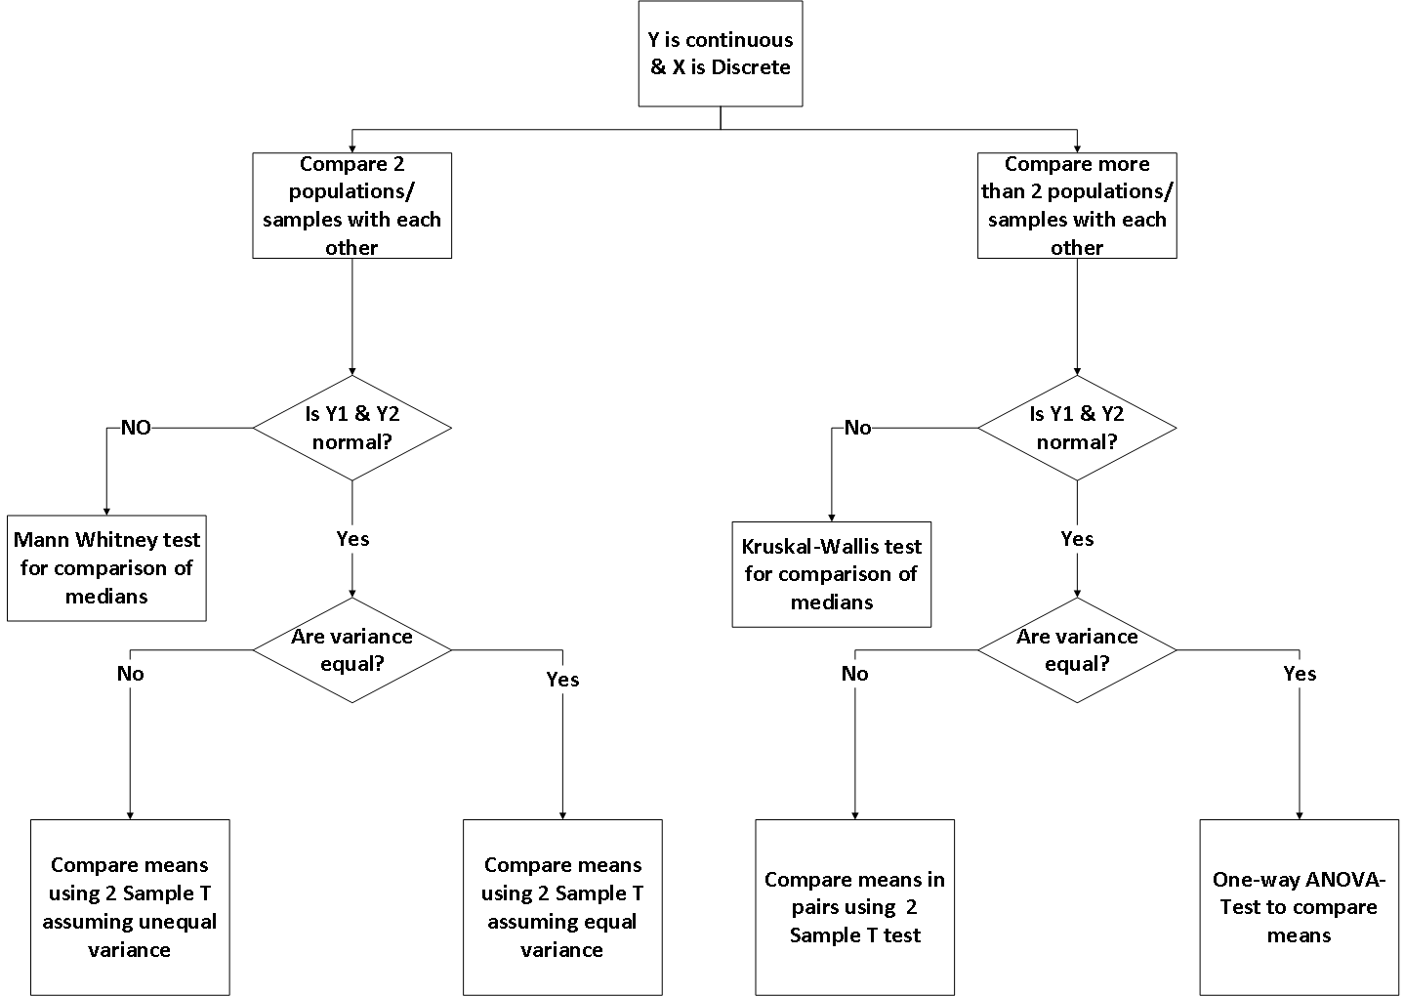
Continuous Y and Discrete X
40

Slide 4
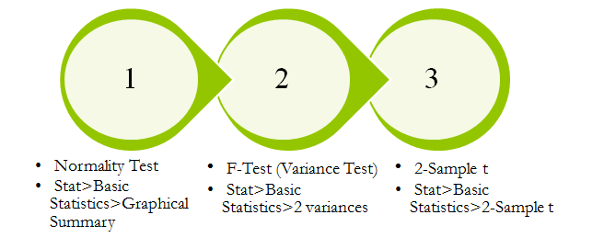
2 Sample t-Test
Marketing Strategy
A financial analyst at a Financial institute wants to evaluate a recent credit card promotion. After this promotion, 450 cardholders were randomly selected. Half received an ad promoting a full waiver of interest rate on purchases made over the next three months, and half received a standard Christmas advertisement. Did the ad promoting full interest rate waiver, increase purchases?

Slide 5
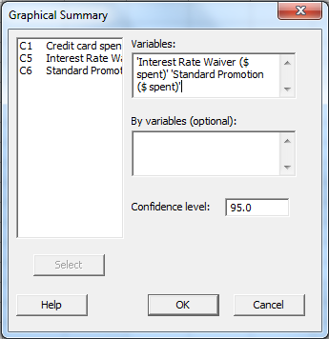
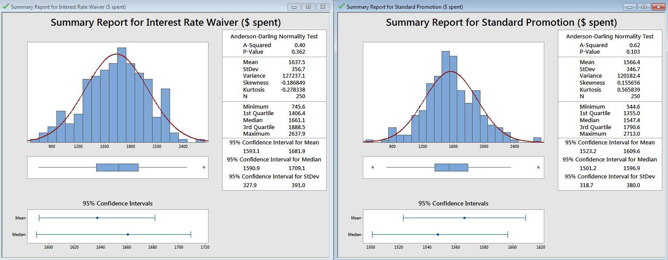
Step 1: Normality test
Ho: Data are normal Ha: Data are not normal
Check Anderson-Darling p-value

Slide 6
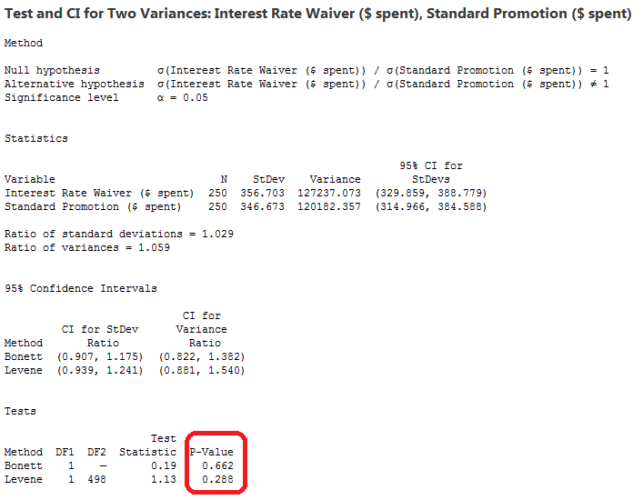
Step 2: 2 Variances test
Ho: Variance (A) = Variance (B)
Ha: Variance (A) not equal to Variance (B)
Check for Bonett test p-Value
Stat -> Basic Statistics -> 2 Variances

Slide 7
Step 3: 2-Sample t test
Ho: Mu(A) = Mu(B)
Ha: Mu(A) not equal Mu(B)
Stat -> Basic Statistics -> S-Sample t
Check “Assume equal variances” based on Bonett-test & check t-test p-value

Slide 8
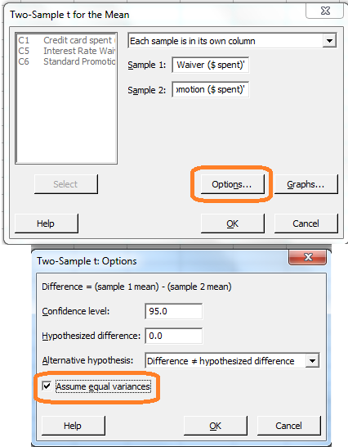
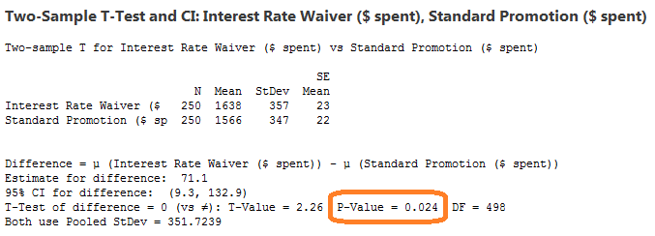
Step 3: 2-Sample t test

Slide 9
Doubts answered!
Why do we check whether the data follows normaldistribution?
2- independent sample t-test assumes that the data follows normal distribution and therefore we carry out normality test. We may carry out Anderson-Darling normality test and if p-value is more than alpha, we consider that data are normal
What is Bonett-test for?
Bonett-test is used to compare variances of two groups. It tests the hypothesis whether there is any difference between two population variances
Bonett-test results help us determine whether we should assume equal variances or not while carrying out 2-independent sample t test
What is 2-independent sample t-test for?
2-independent sample t-test
•
compares and tests the difference between the
means of two independent populations
2-independent sample t-test are of depending on Bonett-test results
two types and we choose one of them
2-independent sample t-test assuming equal variances
2-independent sample t-test assuming unequal variances

Slide 10
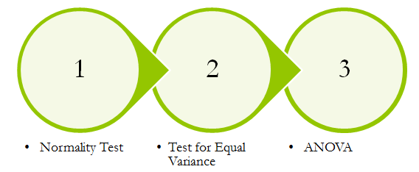
One-Way ANOVA
Contract Renewal
A marketing organization outsources their back-office operations to three different suppliers. The contracts are up for renewal and the CMO wants to determine whether they should renew contracts with all suppliers or any specific supplier. CMO want to renew the contract of supplier with the least transaction time. CMO will renew all contracts if the performance of all suppliers is similar

Slide 11
Continuous Y and Discrete X

Slide 12
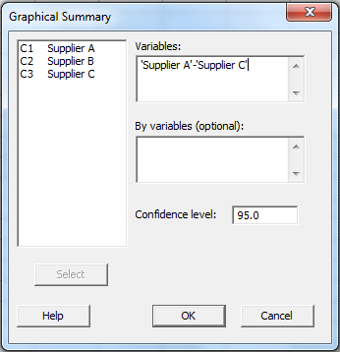
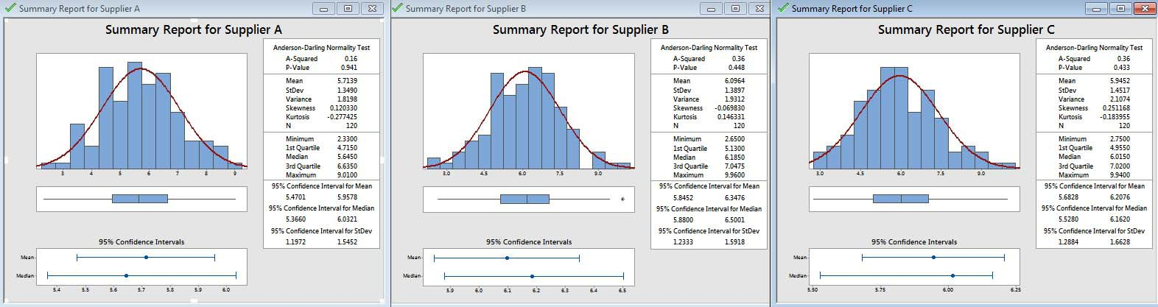
Step 1: Normality Test
Ho: Data are normal Ha: Data are not normal
Check Anderson-Darling p-Value
Stat -> Basic Statistics -> Graphical Summary

Slide 13
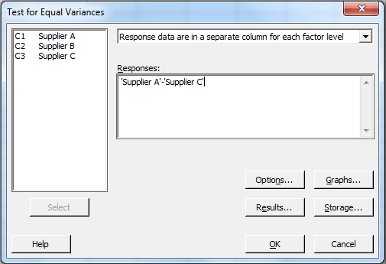
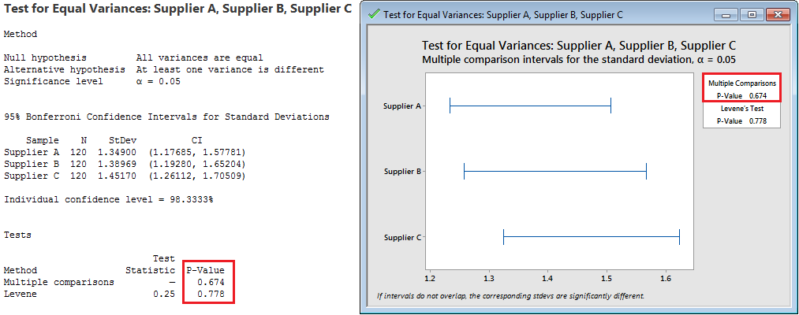
Step 2: Test for Equal Variances
Ho: All variances are equal Ha: Not all variances are equal
Stat -> ANOVA -> Test for Equal Variances
50

Slide 14
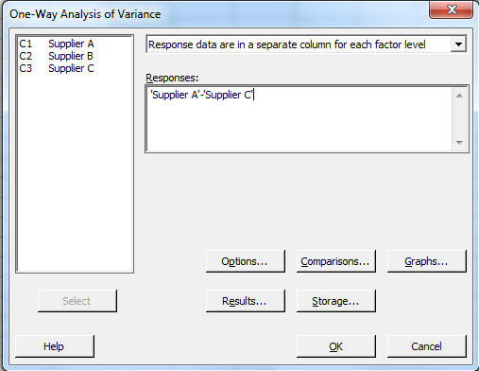
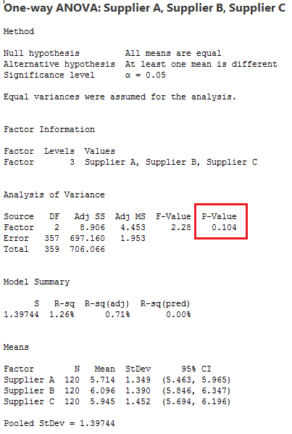
Step 3: ANOVA-One Way
Ho: All means are equal Ha: Not all means are equal
Stat -> ANOVA -> One-Way

Slide 15
ANOVA
Why do we check whether the data follows normal distribution?
ANOVA One-Way assumes that the data follows normal distribution and therefore we carry out normality test. We look into Anderson-Darling normality test p-Value & if it is more than alpha, we consider that data follows normal distribution
What is Levene and Multiple Comparisons test for?
Levene and Multiple Comparisons tests can be used to test variances of several groups
Multiple Comparisons test for variances assumes that the data follows normal distribution however Levene doesn't make any such assumptions
Test for equal variances is carried out to satisfy assumption of homoscedasity (equal variances) for ANOVA-One way
What is ANOVA for?
Analysis of Variances - One Way tests to determine whether means of several groups are equal or not
Underlying Assumptions of ANOVA - One way
Within each sample, the values are independent
The k samples are normally distributed
The samples are independent of each other
The k samples are all assumed to come from populations with the same variance

Slide 16
Application Examples
2 Sample t-test | ANOVA – One Way
Is the Transaction time dependent on whether person A or B processes the transaction? | Does the productivity of employees vary depending on the three levels? (Beginner, Intermediate and Advanced
Is medicine 1 effective or medicine 2 at reducing heart stroke? | Three different sale closing methods were used. Which one is most effective?
Is the new branding program more effective in increasing profits? | Four types of machines are used. Is weight of the Rugby ball dependent on the type of machine used?

Slide 17
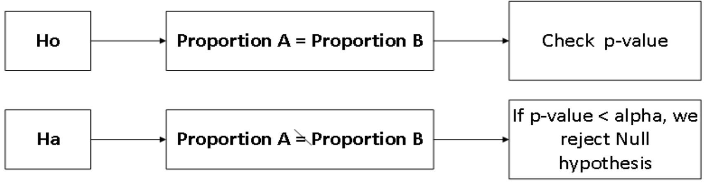
2-Proportion Test
2- Proportion test - A hypothesis test to compare two population proportions to determine whether they are significantly different or not
E.g.
you have samples of camera lens from two different suppliers and you wish to determine if the proportion of camera lens that fail is different depending on the suppliers
you have data for samples of animals who received an experimental vaccine and wish to determine if the proportion of animals that get sick in this group is
different from that of an unvaccinated group

Slide 18
Hypothesis Testing & Graphical Techniques
Y | X | Test
Continuous | Discrete more than 2 categories | ANOVA (single factor)
Continuous | Discrete in 2 categories | t-Test
Continuous | Continuous | Regression
Discrete | Discrete in 2 categories | 2-proportion test
Discrete | Discrete multiple categories | Chi-square test

Slide 19
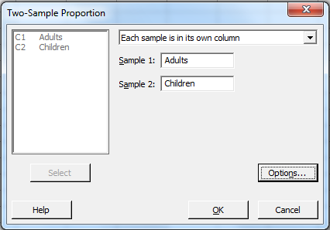
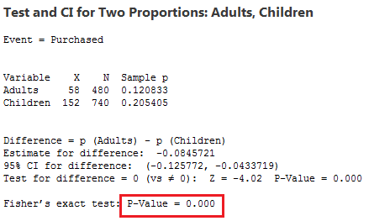
2-Proportion Test
Stat -> Basic Statistics -> 2-Proportion
Johnnie Talkers
Johnnie Talkers soft drinks division has been planning to launch a new sales incentive program for their sales executives. The sales executives have earlier suggested that adults (>40 yrs) won’t buy, children will. Analyze the data & determine whether there is evidence at 5% significance level to support the hypothesis

Slide 20
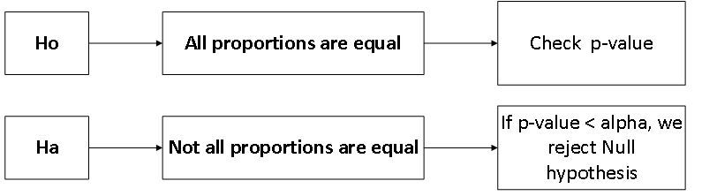
Chi-Square Test
Chi-Square Test is the Test of Homogeneities
It is used to compare the homogeneity of proportions of several groups
Chi square test, has some assumptions:
The sample must be randomly drawn from the population
Data must be reported in raw frequencies (not percentages)
Measured variables must be independent
Values/categories on independent and dependent variables must be mutually exclusive and collectively exhaustive
Observed frequencies cannot be too small

Slide 21
Hypothesis Testing & Graphical Techniques
Y | X | Test
Continuous | Discrete more than 2 categories | ANOVA (single factor)
Continuous | Discrete in 2 categories | t-Test
Continuous | Continuous | Regression
Discrete | Discrete in 2 categories | 2-proportion test
Discrete | Discrete multiple categories | Chi-square test

Slide 22
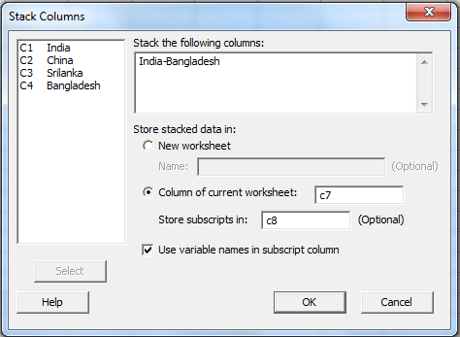
Chi-Square Test
Data -> Stack -> Columns
Bahamantech Research Company uses 4 regional centers in South Asia (India, China, Srilanka and Bangladesh) to input data of questionnaire responses. They audit a certain % of the questionnaire responses versus data entry. Any error in data entry renders it defective. The chief data scientist wants to check whether the defective % varies by country. Analyze the data at 5% significance level and help the manager draw appropriate inferences. [‘1’ means not defectives & ‘0’ means defective]
Bahaman Research

Slide 23
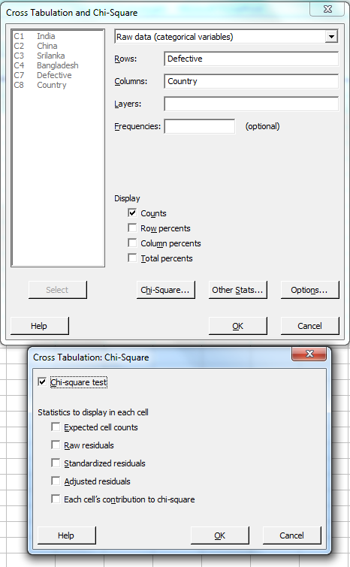
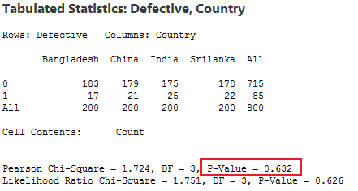
Chi-Square Test
Stat -> Table -> Cross Tabulation & Chi Square
60

Slide 24

Chi-Square Test of Homogeneity
USA UK China India
Adults | 50 | 1021 | 1031 | 170
Children | 435 | 1523 | 1356 | 750
Chi-Square Table
Sales of products in four different regions is tabulated for Adults and Children. Find if male-female buyer rations are similar across countries.

Slide 25
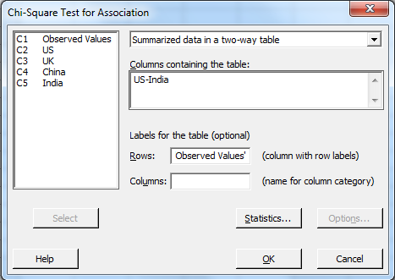
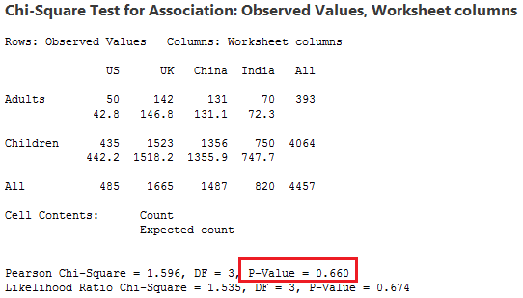
Chi-Square Test of homogeneity
Stat -> Tables -> Chi-Square Test for Association

Slide 26
Hypothesis Testing & Graphical Techniques
Y | X | Test
Continuous | Discrete more than 2 categories | ANOVA (single factor)
Continuous | Discrete in 2 categories | t-Test
Continuous | Continuous | Regression
Discrete | Discrete in 2 categories | 2-proportion test
Discrete | Discrete multiple categories | Chi-square test

Slide 27
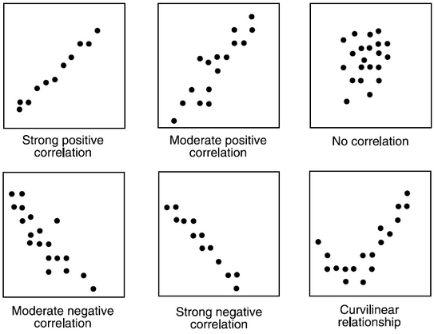
Scatter Diagrams
Scatter diagrams or plots provides a graphical representation of the relationship of two continuous variables
Be Careful - Correlation does not guarantee causation. Correlation by itself does not imply a cause and effect relationship!
Judge strength of relationship by width or tightness of scatter
Determine direction of the relationship, e.g. If X increases, and Y decreases, it is negative correlation, similarly if X increases, and Y increases, it is positive correlation

Slide 28
Correlation Analysis
Correlation Analysis measures the degree of linear relationship between two variables
Range of correlation coefficient -1 to +1
Perfect positive relationship +1
No Linear relationship Perfect negative relationship -1
If the absolute value of the correlation coefficient is greater than 0.85, then we say there is a good relationship
Example: r = 0.87, r = -0.9, r = 0.9, r = -0.87 describe good relationship
Example: r = 0.5, r = -0.5, r = 0.28 describe poor relationship
Correlation values of -1 or 1 imply an exact linear relationship. However, the real value of correlation is in quantifying less than perfect relationships
We can perform regression analysis, which attempts to further describe this type of relationship, if the correlation is good between the 2 variables

